Slide 1
This is your presentation title

Slide 2
This is a slide title
Here you have a list of items
And some text
But remember not to overload your slides with content
Your audience will listen to you or read the content, but won’t do both.

Slide 3
1.
Transition headline
Enter your subtitle here

Slide 4
In two or three columns
Yellow
Is the color of gold, butter and ripe lemons. In the spectrum of visible light, yellow is found between green and orange.
Blue
Is the colour of the clear sky and the deep sea. It is located between violet and green on the optical spectrum.
Red
Is the color of blood, and because of this it has historically been associated with sacrifice, danger and courage.

Slide 5
You can also split your content
White
Is the color of milk and fresh snow, the color produced by the combination of all the colors of the visible spectrum.
Black
Is the color of ebony and of outer space. It has been the symbolic color of elegance, solemnity and authority.

Slide 6
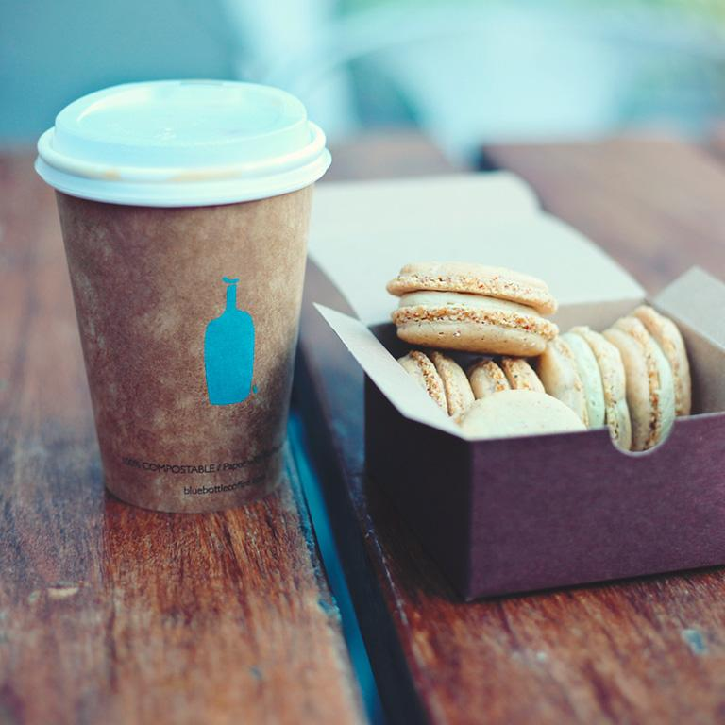
A picture is worth a thousand words
A complex idea can be conveyed with just a single still image, namely making it possible to absorb large amounts of data quickly.
**Contacting CNE marketing for any imagery needs**

Slide 7
Have a quote you want to share? Use this slide to showcase it!

